Slide 1
DIGITAL DESIGN & COMPUTER ARCHITECTURE
2026–27
8-BIT REGISTER WITH LOAD ENABLE
Design, Implementation, and Simulation using D Flip-Flops in Logisim
Team Members:
Phani Kumar
Jashvitha Reddy
Srujan
Akshaj Sai
Roll Numbers:
2620080016
2620080009
2620080010
2620080021
Section: 4

Slide 2
2. INTRODUCTION & OBJECTIVE
DDCA • PROJECT
What is an 8-Bit Register?
Project Purpose
A group of eight D flip-flops sharing a common clock signal to store 1 byte of binary data simultaneously.
Implement a Load Enable control input so the register updates data only when enabled, holding previous values otherwise.
BEHAVIOR RULE:
Load = 1 → Update Data | Load = 0 → Hold Stored Value

Slide 3
3. THEORY & LOGIC CIRCUIT
DDCA • PROJECT
D Flip-Flop Base
2-to-1 Multiplexer
Circuit Equation
Stores 1 bit of memory. On the active rising clock edge, captures input D to output Q.
Placed before each flip-flop. Selects external input when Load=1, or feedback output when Load=0.
Di = (L · Xi) + (L̅ · Qi)
Ensures stable feedback loop when Load is inactive.

Slide 4


4. CIRCUIT DESIGN IN LOGISIM
DDCA • PROJECT
Bit-Slice Architecture
Working Principle
Eight identical 1-bit registers combined in parallel. All units share the common clock (CLK) and Load Enable (L) lines.
When CLK pulses while L=1, the 8-bit input bus data is latched. When L=0, internal feedback preserves the stored word.

Slide 5
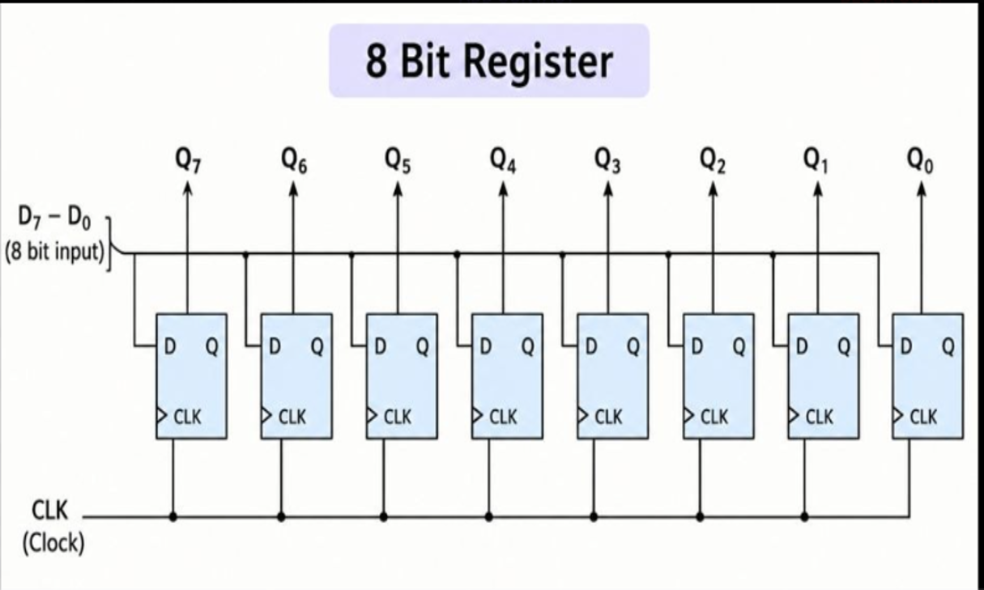
5. SIMULATION RESULTS & OUTPUT
DDCA • PROJECT

Slide 6
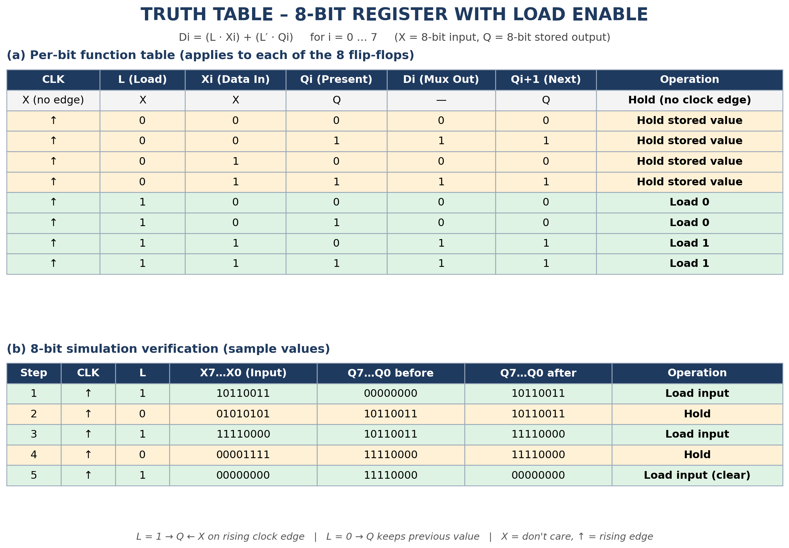
6. TRUTH TABLE & VERIFICATION
DDCA • PROJECT

Slide 7
7. CONCLUSION & APPLICATIONS
DDCA • PROJECT
Practical Applications
Project Outcome
• CPU Registers: Temporary data holding in arithmetic units.
• Data Buffering: Synchronizing transfers across buses.
• I/O Ports: Latching peripheral inputs.
Successfully designed and simulated an 8-bit register with precise load control, validating synchronous storage operations.

